Slide 1
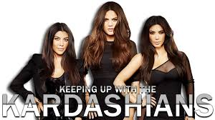
CHEM

Slide 2
Kourtney
Kourtney is always eating organic food. Name the products of the organic reaction of ‘fermentation’.
Which organic reaction takes place between a saturated hydrocarbon and a halogen?

Slide 3
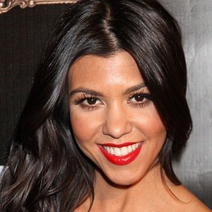
Kourtney
Kourtney Kardashian drives a
Range Rover that requires 92
octane gasoline.
How many carbons are in octane?
Describe the bonds between carbons.
Is octane a saturated or unsaturated hydrocarbon?

Slide 4
Kylie
If Kylie’s lips have a volume of 20 mL at 330K, what would the volume of her lips be if the temperature increased to 350K? Assume pressure is constant.

Slide 5
Kylie
Kylie occasionally wears blue hair extensions. List all of the acid-base indicators that will turn blue when added to a solution with a pH of 13.

Slide 6
Kim
Occasionally, Kim will bleach her hair. The chemical formula for bleach is
NaClO.
What is the gram formula mass of this molecule?
What is the percent composition of oxygen?

Slide 7
Kim
Kim wears a LOT of makeup.
Cr₂O₃ is used to make
powdered makeup green.
What is the name of this
compound?
In terms of element classification, why does this have a color to it?

Slide 8
North
North LOVES her glow sticks!
In terms of electrons and energy, how does the chemical reaction product light energy once the chemicals are mixed?

Slide 9
KANYE
When Kanye talks about
himself, 20g of hot air
& steam comes out of
head.
If all 20g of the steam condenses, calculate the joules of energy lost during change.

Slide 10
KANYE
During the construction of their
new house, the lawn was completely
destroyed from the construction
Vehicles. Kanye called his landscaper
who put AMMONIUM SULFATE all over the yard as a fertilizer.
What is the chemical formula of ammonuium sulfate?

Slide 11
The Kardashians pour 20g of acetic acid (vinegar) on their salad. How many moles of acetic acid is this equal to?

Slide 12
When Khloe spilled olive oil on her hands, it did not rinse off with water. In terms of polarity and solubility, why doesn’t oil rinse off with water?

Slide 13
KENDALL
On her way to NY Fashion Week, Kendall realized her height was incorrectly listed on her resume. It was listed at 72 inches when she is actually 70 inches.
What is the percent error in height listed on her resume?

Slide 14
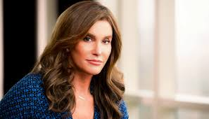
caitlyn
Caitlyn Jenner won the gold metal for the decathlon in 1976. What is the volume of the medal if it has a mass of 532g and is solid gold.

Slide 15
caitlyn
Caitlyn bought an amazing house in Malibu right on the ocean. Sea water contains roughly 28.0 g of NaCl per liter.
What is the molarity of sodium chloride in sea water?

